Slide 1
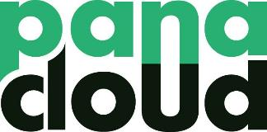
The Token Economy
Bootcamp 2021
https://panacloud.github.io/bootcamp-2021/

Slide 2

Web 2.0?
Web 2.0, coined as such by O’Reilly and others between 1999 and 2004, moved the world on from static desktop web pages designed for information consumption to interactive experiences and user-generated content that brought us Uber, AirBnB, Facebook and Instagram.
The rise of Web 2.0 was largely driven by three core layers of innovation: mobile, social and cloud.
Notes:
https://medium.com/fabric-ventures/what-is-web-3-0-why-it-matters-934eb07f3d2b

Slide 3
Web 3.0?
Web 3.0 is an even more fundamental disruption, one that in time will leave everything hitherto in its shade. It is a leap forward to open, trustless and permissionless networks.
‘Open’ in that they are built from open source software built by an open and accessible community of developers and executed in full view of the world.
‘Trustless’ in that the network itself allows participants to interact publicly or privately without a trusted third party.
‘Permissionless’ in that anyone, both users and suppliers,can participate without authorisation from a governing body.
Notes:
https://medium.com/fabric-ventures/what-is-web-3-0-why-it-matters-934eb07f3d2b

Slide 4
Minimum Trust Required?
With Web 3.0, women, men, machines & businesses will be able to trade value, information & work with global counterparties they don’t know or yet explicitly trust, without an intermediary.
The most important evolution enabled by Web3.0 is the minimisation of the trust required for coordination on a global scale.
This marks a move towards trusting all constituents of a network implicitly rather than needing to trust each individual explicitly and/or seeking to achieve trust extrinsically.
Web 3.0 will enable us to interact with any individual or machine in the world, without having to pass through fee-charging middlemen.
This shift will enable a whole new wave of previously unimaginable businesses and business models: from global co-operatives to decentralised autonomous organisations and self-sovereign data marketplaces.
Notes:
https://medium.com/fabric-ventures/what-is-web-3-0-why-it-matters-934eb07f3d2b

Slide 5
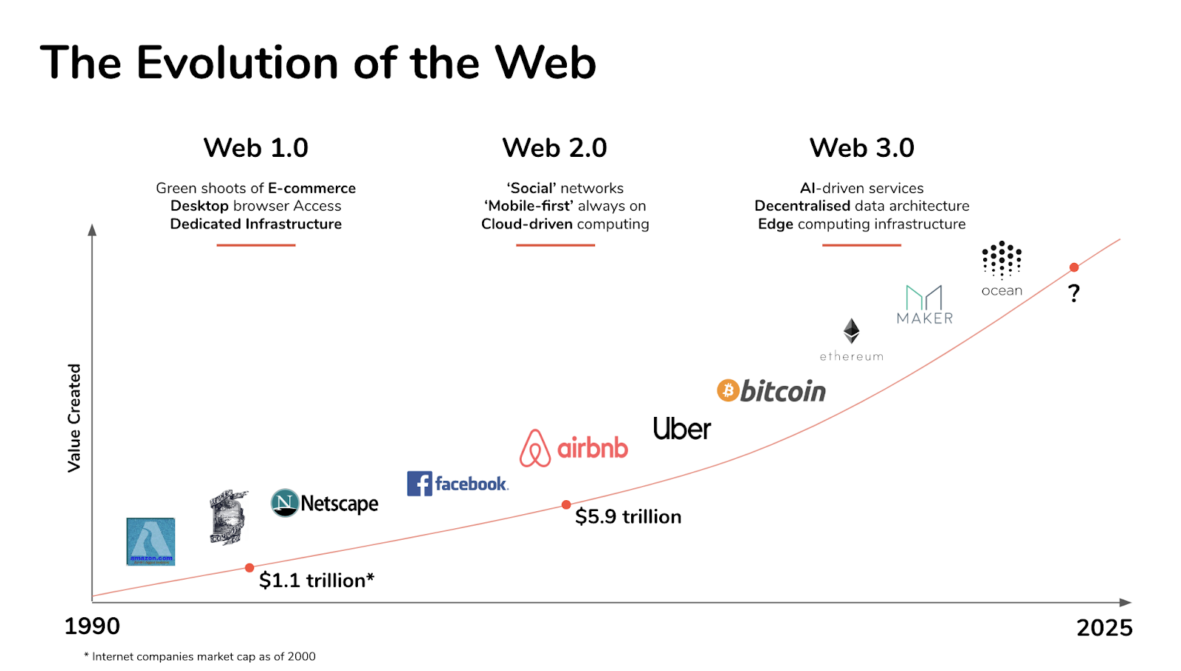
Notes:
https://medium.com/fabric-ventures/what-is-web-3-0-why-it-matters-934eb07f3d2b
Maker: Decentralized governance. A community of MKR token holders govern the Maker Protocol, the smart contracts that power Dai.
The OCEAN utility token is used to stake on data, govern community funding, and buy & sell data. Its supply is disbursed over time to drive near-term growth and long-term sustainability. Data is a new asset class.
Ocean Protocol unlocks the value of data.
Data owners and consumers use Ocean Market app to publish, discover, and consume data assets in a secure, privacy-preserving fashion. OCEAN holders stake liquidity to data pools.
Developers use Ocean libraries to build their own data wallets, exchanges, and more.
Ocean datatokens turn data into data assets. This enables data wallets, data exchanges, and data co-ops by leveraging crypto wallets, exchanges, and other decentralized finance (DeFi) tools.

Slide 6
Economics?
Economics is a science. It primarily examines how decisions are made, which alternatives provide greatest benefits to various stakeholders.
Contrary to popular belief, economics is not about money. It has and continues to be about the study of allocation of scarce resources (behaviours). We enforce them through incentives and disincentives (punishments).
The difference between economics (soft science) and physics (hard science) is that economics is continuously evolves because it is a study of human behaviours.
Notes:
https://www.oreilly.com/library/view/what-is-the/9781492072973/ch01.html

Slide 7
What is a Token? (1)
Cryptographic tokens represent programmable assets or access rights, managed by a smart contract and an underlying distributed ledger such as a blockchain network.
Tokens can represent anything from a store of value to a set of permissions in the physical, digital, and legal world.
They can also incentivize an autonomous group of people to individually contribute to a collective goal.
Notes:
https://www.oreilly.com/library/view/what-is-the/9781492072973/ch01.html

Slide 8
What is a Token? (2)
Tokens, in a general sense, are units of value issued by an organization, but in the context of tokenomics, it is more specifically built on top of an existing blockchain.
Tokens have been rebranded with the advent of blockchain, but tokens have always been around. Concert tickets, gym membership cards, and drivers licenses are all examples of tokens representing value with a more specific use case than currency.
This value may be in the form of access to a service, rights over an asset, ownership of an organization, etc. Tokens can thus fulfill different roles in any given native ecosystem by codifying all kinds of values.
Notes:
https://www.upgrad.com/blog/what-is-tokenomics/

Slide 9
Token Economics must make sense
As we moved from Web 1 to Web 2 and now Web 3, the economics 101 that we initially understood has changed.
While is important to be coding the tech infrastructure of Web 3.0 and having ideas of what Web 3.0 is like, an important aspect is the economics and incentive alignment of Web 3.0 users.
It is easy to create a token or currency out of thin air. The token is only valuable when the economics make sense.
Notes:
https://www.oreilly.com/library/view/what-is-the/9781492072973/ch01.html

Slide 10
The idea of the token economy was propounded first by the Harvard psychologist B.F. Skinner in 1972. He believed a token economic model could control behavior. Giving some unit of recognizable value would incentivize positive actions and vice versa.
Notes:
https://decrypt.co/resources/tokenomics

Slide 11
What is Tokenomics?
Tokenomics is the science of the token economy. It covers all aspects involving a coin’s creation, management, and sometimes removal from a network.
Tokenomics is the study of how cryptocurrencies work within the broader ecosystem. This includes such things like token distribution as well as how they can be used to incentivize positive behaviour in the network.
Until now central banks were the only institutions in most states authorized to issue currency to their citizens.
Cryptocurrency has changed this. Individuals can create their own micro-economies. Tokenomics essentially takes what central banks use as monetary policy and apply it in blockchain networks.
Notes:
https://decrypt.co/resources/tokenomics

Slide 12
Creation: Token distribution
Projects need to be able to distribute coins out to prospective users. If not, the network can exist but no one will be able to use it!
There are different ways this can be achieved:
The networks reward validators, or miners, with newly minted coins.
Sell a portion of the token supply to prospective users in an initial coin offering (ICO).
Distribute token to users via certain actions and behaviours. Augur for example, rewards people for verifying facts on its betting network.
Notes:
https://decrypt.co/resources/tokenomics

Slide 13
Price Stability
Cryptocurrencies are notorious for their volatility.
This is a problem as fluctuations attract speculators who can stop the network from working properly by buying and selling en masse.
Projects can combat this by ensuring there are enough coins to match the levels of supply.
This helps to create a stable price for the coin, which encourages people to use the tokens for what they’re designed for.
Notes:
https://decrypt.co/resources/tokenomics

Slide 14
Governance
The core team behind each project devises the rules by how tokens are created, or ‘minted’, as well as how they are injected into, and taken out of, the network. Different projects take different approaches.
Some projects can include tokens held in reserve which can be added into the ecosystem at a later point, as a way to promote growth or to pay for system maintenance. Ripple is a good example of this.
Other projects meanwhile take a deliberate hands-off approach to how the network works. Augur's developers, for example, play no role in how the network runs, it merely maintains the infrastructure.
A network like Tether however, in October 2018, 'burned' tokens to help regulate the coin's value in the marketplace. The act of burning happens when currency is sent to a wallet that no one knows the address.
Notes:
https://decrypt.co/resources/tokenomics

Slide 15
Tokens as governance
Some networks incentivise people to own, hold and use tokens as a way of preventing people from HODLing coins and preventing the network being used as it was designed.
Proof-of-Stake (PoS) systems, which rely on validators to actually ‘stake’ their own coins, helps ensure they act honestly and fairly. If they don’t play by the rules, their tokens can be forfeited.
Notes:
https://decrypt.co/resources/tokenomics

Slide 16
Future Adoption
Most teams building a network won’t go on to be its rulers. That’s not how decentralization works.
However, most developers know that what they build now may not necessarily work in the future. The way in which tokens are governed may need to be altered as the network grows and matures.
Some, but not all, have come up with provisions to how network users can effectively change the way tokens are managed within the ecosystem through consensus.
Notes:
https://decrypt.co/resources/tokenomics

Slide 17
Why is tokenomics important?
Blockchain technology enables projects to create micro-economies.
To become self-sustaining, they need to figure out how tokens should work within their ecosystem.
There can be ‘no one size fits all’ attitude when it comes to tokens. Blockchain has enabled a diverse range of use cases and implementations.
Tokenomics enables teams to create a new or adapt an existing model that works with what the project wants to achieve. This can create a high-functioning and stable platform, if done well.
Notes:
https://decrypt.co/resources/tokenomics

Slide 18
The Future?
The principles, philosophies and models by which tokens, coins and the projects that underpin are at the very beginning of experimenting with what works, and what doesn't.
There are plenty of model that won't work, and we expect those projects will fade away.
But for the ones that do, will go on to inspire and guide new projects still to come.
Notes:
https://decrypt.co/resources/tokenomics

Slide 19
Layer 1 vs. Layer 2
Layer 1 (protocol tokens):
These tokens are the underlying blockchain itself. E.g., Ethereum powered by ether (layer 1 token)
Layer 2 :
These tokens are built on top of the existing layer 1 blockchains. We will focus on building Layer 2 token ecosystems using Ethereum.
Notes:
https://www.upgrad.com/blog/what-is-tokenomics/

Slide 20
Security vs utility
Security tokens are those that pass the Howey test, classifying them as securities. Most ICOs (Initial Coin Offering) are investment opportunities in the company itself. Thus, most tokens count as securities.
Utility tokens are issued to raise funds for a project that can later be used to purchase the project’s goods or services.
Notes:
https://www.upgrad.com/blog/what-is-tokenomics/

Slide 21
Non-Fungible Assets
Non fungible assets are those assets that we know in our daily lives and that we can apprehend and that uniquely represent an asset (tickets to an event, paintings, patents).
If we talk about types of fungibility we observe 3 types of assets:
Fungibles: the best known, money. All coins or banknotes are equal and none are worth more than the others (of their series, obviously).
Semi-fungible: seats on a plane between classes (business/tourist) or a run of unique books.
Non-fungible: Any unique piece that has a singular creator and value different from others.
Notes:
https://www.addvante.com/en/nfts-are-the-big-thing-in-todays-crypto-world/

Slide 22
The Properties of Fungible Tokens?
A fungible token is something with units that can be readily interchanged - like money. Fungible tokens have two key properties:
Only quantity matters, which means that units of fungible assets of the same kind are indistinguishable
Any amount can be merged or divided into a larger or smaller amount of it, making it indistinguishable from the rest.
Protocol tokens such as Bitcoin or Ether and smart contract tokens such as ERC-20 tokens, are all examples of fungible tokens.
Notes:
https://www.oreilly.com/library/view/what-is-the/9781492072973/ch01.html

Slide 23
What is NFT?
NFT stands for non-fungible token.
If something is non-fungible, it means it has unique properties so it cannot be interchanged with something else.
NFTs are "one-of-a-kind" assets in the digital world that can be bought and sold like any other piece of property, but they have no tangible form of their own.
The digital tokens can be thought of as certificates of ownership for virtual or physical assets.
ERC-721 is the standard for NFTs.
Notes:
https://www.bbc.com/news/technology-56371912

Slide 24
The uses of NFTs?
An NFT is an opportunity for artistic and intellectual property creators to differentiate themselves by using blockchain technology to avoid being copied and better protect their rights.
The main assets currently offered as NFTs are digital art, physical art, collectibles, in-game assets, virtual properties, rare video, etc.
But they can also extend to physical assets such as real estate, cars, wine, recreational boats, investment gold, and countless others.
Notes:
https://www.addvante.com/en/nfts-are-the-big-thing-in-todays-crypto-world/

Slide 25
What is SFT?
Semi-Fungible Token (SFT) can act as if they are Fungible (ERC-20) or Non-Fungible (ERC-721) tokens or both at the same time and under the same address.
The semi-fungible token is based on Ethereum's ERC-1155 standard, which enables a smart contract to govern an unlimited number of tokens.
The ERC-1155 token standard makes it possible for one smart contract to govern an unlimited number of tokens. Each token is semi-fungible, unlike ERC-721 non-fungible tokens that can only be owned by one address each.
Multiple addresses can own each token, and one address can own multiple copies of each token.
Notes:
https://www.globenewswire.com/fr/news-release/2021/04/29/2220057/0/en/Mocktail-Becomes-The-First-ERC-1155-Standard-Semi-Fungible-Token-SFT-Launched-on-Binance-Smart-Chain.html

Slide 26
$50 dollar Walmart SFT
Each token is fungible (same as each other) until the token is redeemed or used in store.
Once a coupon is redeemed, it no longer holds value and hence shouldn’t be traded as a normal token.
The Walmart SFT may be converted into a NFT.
In this example, the coupon is “fungible” until it is redeemed (“non-fungible”), hence the name semi-fungible token.
Once fungible tokens redeemed to non-fungible that can be traded on the growing NFT marketplace.
Notes:
https://boxmining.com/erc-1155/

Slide 27
Mocktail: The First ERC-1155 Standard Semi-Fungible Token (SFT)
ERC-1155 standard tokens can act as if they are ERC-20 or ERC-721 tokens or both at the same time and under the same address.
In Mocktail’s case, the token will serve as the first-ever semi-fungible token, where the token will be “fungible” until its redeemed when it becomes “non-fungible.”
The ERC-1155 token standard makes it possible for one smart contract to govern an unlimited number of tokens.
Each token is semi-fungible, unlike ERC-721 non-fungible tokens that can only be owned by one address each.
This feature has a few implications for the Mocktail token; multiple addresses can own each token, and one address can own multiple copies of each token.
Notes:
https://www.globenewswire.com/fr/news-release/2021/04/29/2220057/0/en/Mocktail-Becomes-The-First-ERC-1155-Standard-Semi-Fungible-Token-SFT-Launched-on-Binance-Smart-Chain.html

Slide 28
Other Token Properties
Rights: tokens may give the holder property rights or give the holder access rights.
Durability: tokens can remain stable in the face of censorship and attacks.
Regulatory: tokens are easy to classify and regulate (if required)
Purpose: tokens are created to serve as proof of behavior (value creation) or represent existing assets/access rights
Supply: there may be a fixed supply of token or unlimited
Token-flow: tokens can be generated linearly (destroyed after use) or remain in circulation
Temporal: tokens may or may not have an expiration date
Notes:
https://www.globenewswire.com/fr/news-release/2021/04/29/2220057/0/en/Mocktail-Becomes-The-First-ERC-1155-Standard-Semi-Fungible-Token-SFT-Launched-on-Binance-Smart-Chain.html

Slide 29
Investments and Tokenomics
With a greater number of projects funding themselves using ICOs, it has become important for investors to develop tools to analyze the viability of their investment opportunities. Factors that investors may consider in assessing a token project are as follows:
The team: the credentials and reliability of the team that is behind the project
Business model: how robust is the business model, as the complexity of tokens scales from simple payment mechanisms
PR and branding: how well the project is being able to mobilize the community
Legality: legality around tokens remains murky in many jurisdictions, and thus projects need a good legal team to make sure the project has sound legal grounds.
Token structure: technical aspects of the nature of the token
Notes:
https://www.upgrad.com/blog/what-is-tokenomics/

Slide 30
Tokens a new way of Funding Companies
Tokens are a powerful new way of funding companies.
The ICO, IDO, and IEO, phenomenon presents a huge threat to the traditional VC model. They offer an opportunity for liquid investments and faster exits. The primary reason for the rise of these offering is the difficulty that startups face, when they try raise a VC round.
A security token is a digital object that represents ownership of some real-world asset.
A utility token is a digital object that represents credit to use a product or participate in the activity of a dApp.
Making VC funds liquid will also transform the entire VC industry.
Notes:
https://coinmarketcap.com/alexandria/glossary/initial-dex-offering
https://www.nfx.com/post/token-investing/

Slide 31
Tokens can better incentivize startup employees than equity
If the tokens are structured properly for a blockchain, external stakeholders will be directly aligned with the goal of the project. Those incentives can encourage participation on the blockchain platform and/or drive token demand with community-building and marketing.
If internal stakeholder incentives are structured correctly, the project could accrue long-term value by motivating employees to work towards the same goal, while reducing adversarial behavior and also bad actors.
One of the largest differences between tokens and equity is that tokens are immediately liquid, assuming that they have already been listed on an exchange. To put simply, equity options only prove their value at the end, whereas tokens have certainty values from the beginning.
Notes:
https://techcrunch.com/2018/09/09/tokens-can-better-incentivize-startup-employees-than-equity/

Slide 32
The Tokenization Of Venture Capital
Traditional venture capital funds are one of the most illiquid asset classes available
A venture capital partnership is a 10-year blind-pool… a long relationship in which investors have limited ability to exit, and no clarity of outcomes.
TOKENIZATION solves the major issue of illiquidity for investors. Making VC funds liquid will also transform the entire VC industry.
Blockchain technologies allow almost any illiquid asset to be "tokenized" in a digital ledger to then become liquid. It creates a broader market with improved price discovery.
Liquidity facilitates broader adoption among a larger investor base.
Notes:
https://www.linkedin.com/pulse/tokenization-venture-capital-rob-frasca/
https://www.finyear.com/Tokenized-Venture-Capital_a41546.html

Slide 33
Data Economy Tokens
Ocean Protocol launched the Ocean Token, along with its Marketplace Framework which outlines the market attributes and components necessary to deploy the decentralised Ocean Protocol data exchange.
Ocean Protocol unlocks the value of data and is a decentralized data exchange protocol that unlocks data for AI​.
Ocean datatokens turn data into data assets.
Ocean Protocol allows users to create a decentralized marketplace, composed of data assets and services that can be exchanged by users.
The marketplace connects data providers and consumers and links to the data itself. It keeps an on-chain record of who owns the data, and who has purchased and shared it.
Notes:
https://www.bitcoinsuisse.com/fundamentals/what-is-ocean-protocol
https://oceanprotocol.com/

Slide 34
API Economy Tokens
Stable Coin DAI for cross border payments.
Revenue Sharing Semi Fungible Tokens (SFTs) for Investments in API-First Companies.
Security Tokens for investment in API-First company equity.
DIDs for Decentralized IDs and authentication.
To influence behavior and encourage API development

Slide 35
IoT Tokens
Chronicled combines blockchain and IoT products to deliver an end-to-end supply chain solution. Focusing on the pharmaceutical and food supply industries, Chronicled uses IoT-enabled shipping containers and sensors to give real-time updates on shipping processes.
NetObjex has created a standardized, decentralized mechanism for IoT devices to communicate with one another. The company’s blockchain-enabled IoToken provides a secure digital platform for smart devices in the same ecosystem to interact and communicate.
HYPR uses decentralized networks to secure connected ATMs, cars, locks and homes.
Notes:
https://builtin.com/blockchain/blockchain-iot-examples

Slide 36
NFT (ERC-721) Lab
Install Mobile Metamask (Please note that while you can add NFT's as custom tokens in the Chrome extension, you will not be able to see them natively in the UI).
Sync Mobile with MetaMask Extension https://metamask.zendesk.com/hc/en-us/articles/360032378452-How-to-Sync-Mobile-with-MetaMask-Extension
Follow this Tutorial to mint NFTs: https://coinmarketcap.com/alexandria/article/how-to-mint-an-nft
OpenSea for Testnetworks (Use Rinkeby testnet only) https://testnets.opensea.io/
OpenSea NFT Tutorial
https://docs.opensea.io/docs/getting-started
Notes:
https://testnets.opensea.io/

Slide 37
SFT (Semi-Fungible Token, ERC-1155) Lab
ERC-1155 Marketplace
https://opensea.io/blog/announcements/erc1155-marketplace/
OpenSea SFT Tutorial
https://docs.opensea.io/docs/opensea-erc1155-tutorial
Notes:
https://testnets.opensea.io/

Slide 38
Build Your own Customized Marketplace
While Label OpenSeas (Fee 2.5%)
https://support.opensea.io/hc/en-us/articles/1500003249342
https://github.com/ProjectOpenSea/opensea-js
How to Build an NFT Marketplace Platform: Using Blockchain and Some Magic
https://medium.com/codica/how-to-build-an-nft-marketplace-platform-using-blockchain-and-some-magic-96d94eaf7861
How to create your own NFT Marketplace to stay competitive in Digital World
https://medium.com/security-token-offering/how-to-create-your-own-nft-marketplace-to-stay-competitive-in-digital-world-396da0847a3a
Notes:
https://testnets.opensea.io/

Slide 39
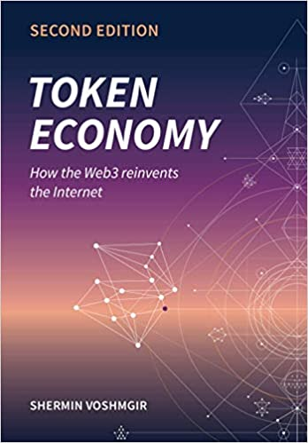
Token Economy Book
https://github.com/sherminvo/TokenEconomyBook
Notes:
https://github.com/sherminvo/TokenEconomyBook

Slide 40
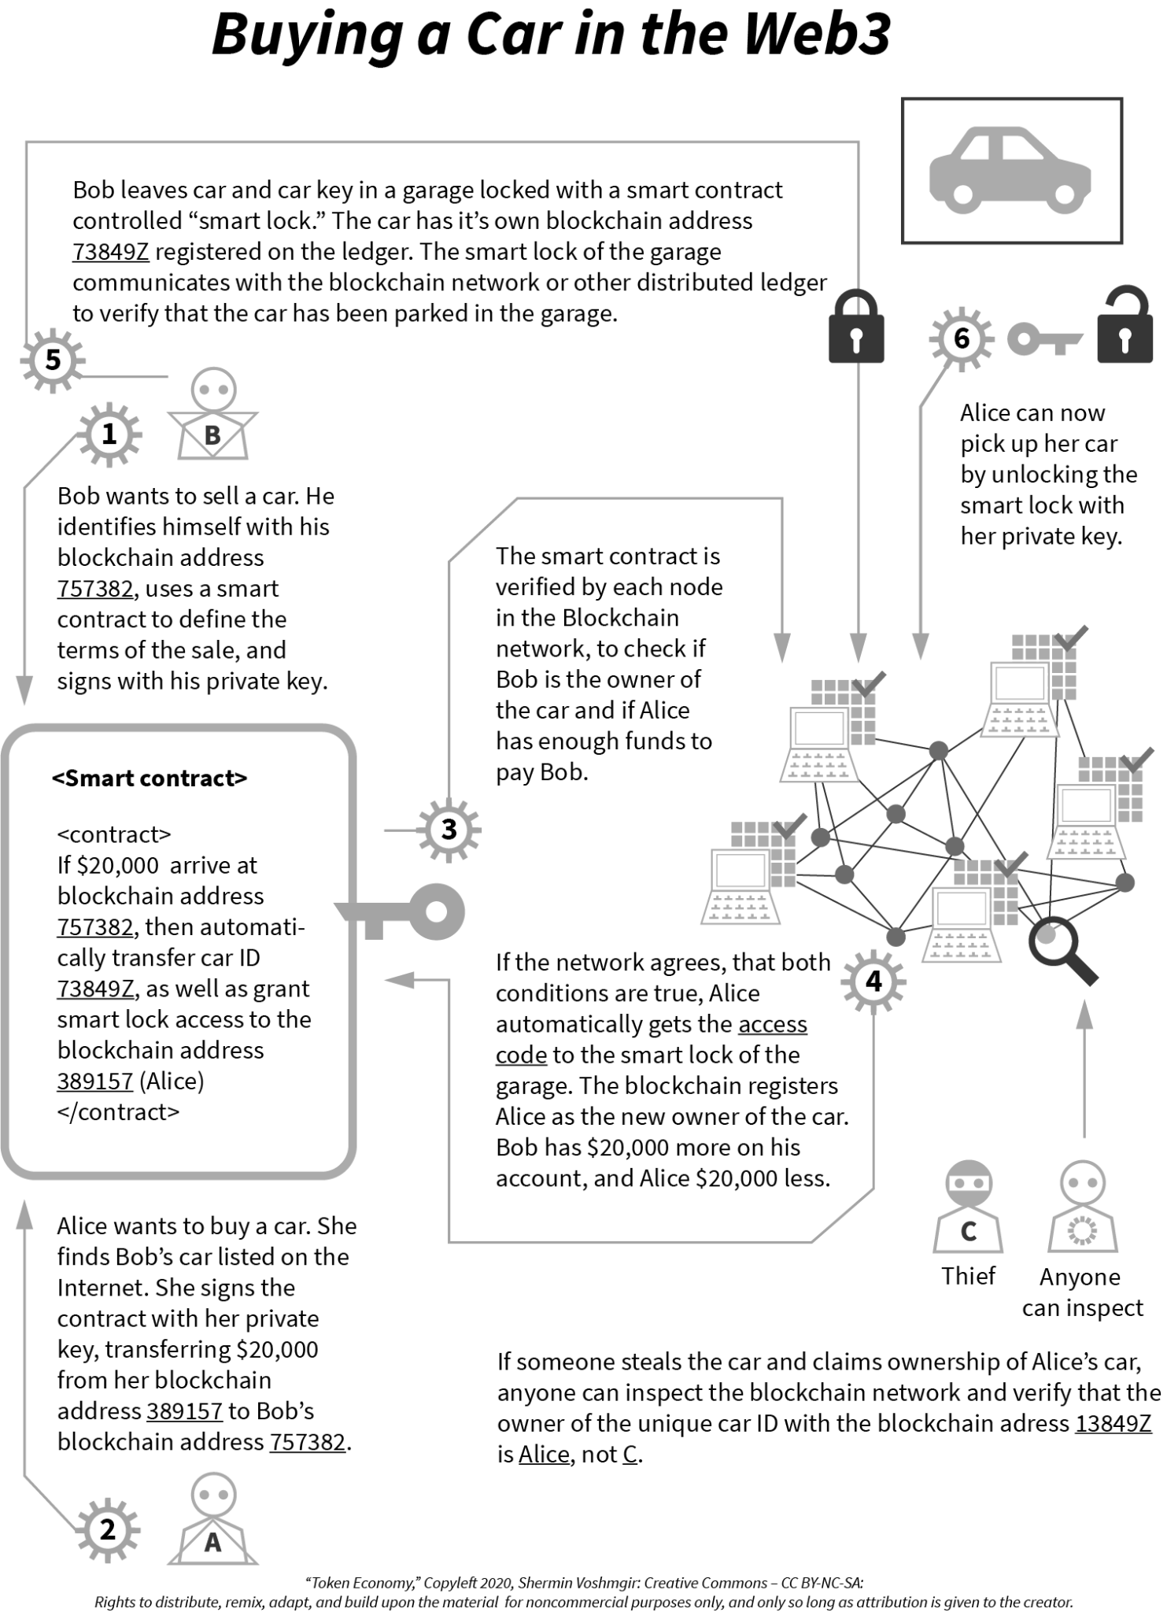
Notes:
https://github.com/sherminvo/TokenEconomyBook/blob/main/imgs/08_BuyingCarWeb3.png

Slide 41
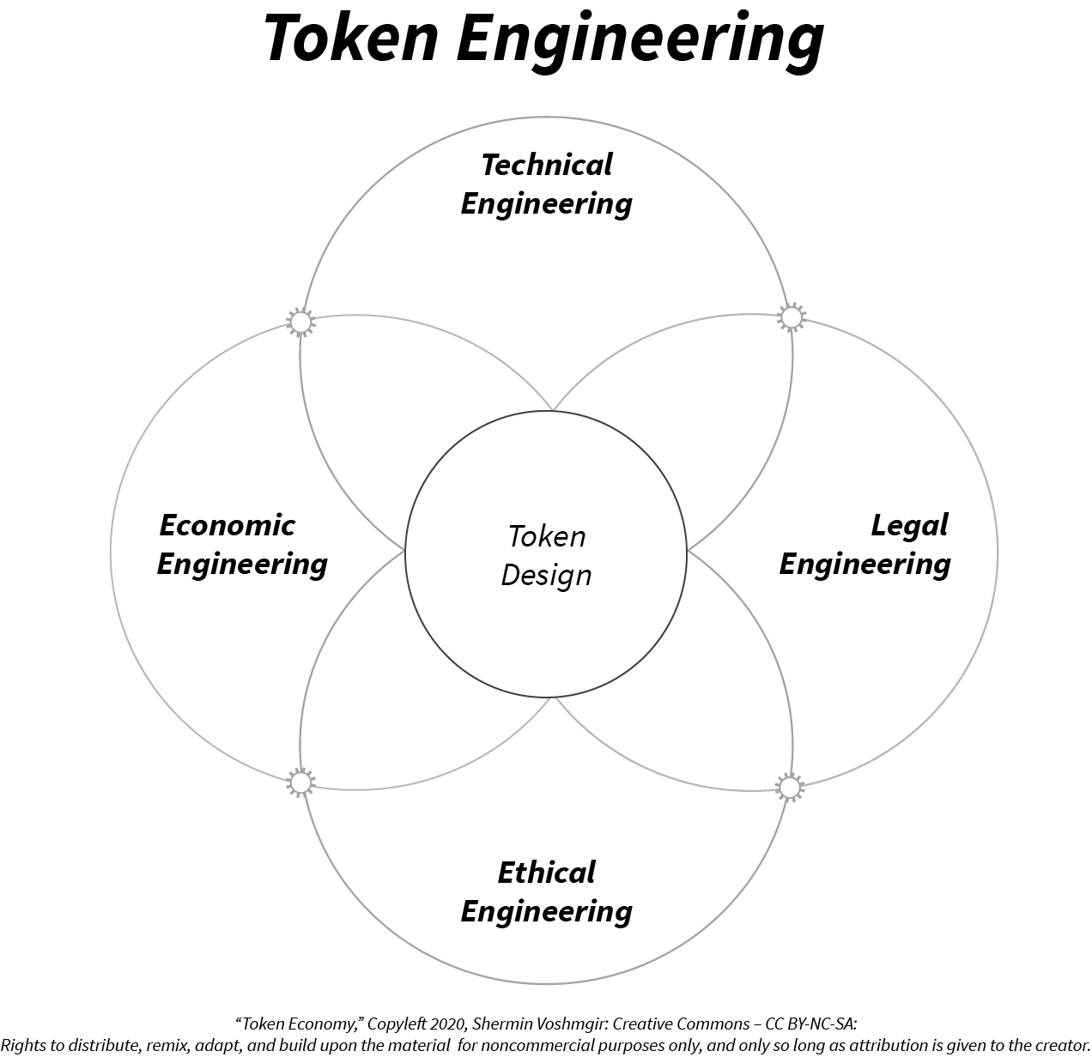
Notes:
https://github.com/sherminvo/TokenEconomyBook/blob/main/imgs/28_TokenEngineering.png

Slide 42
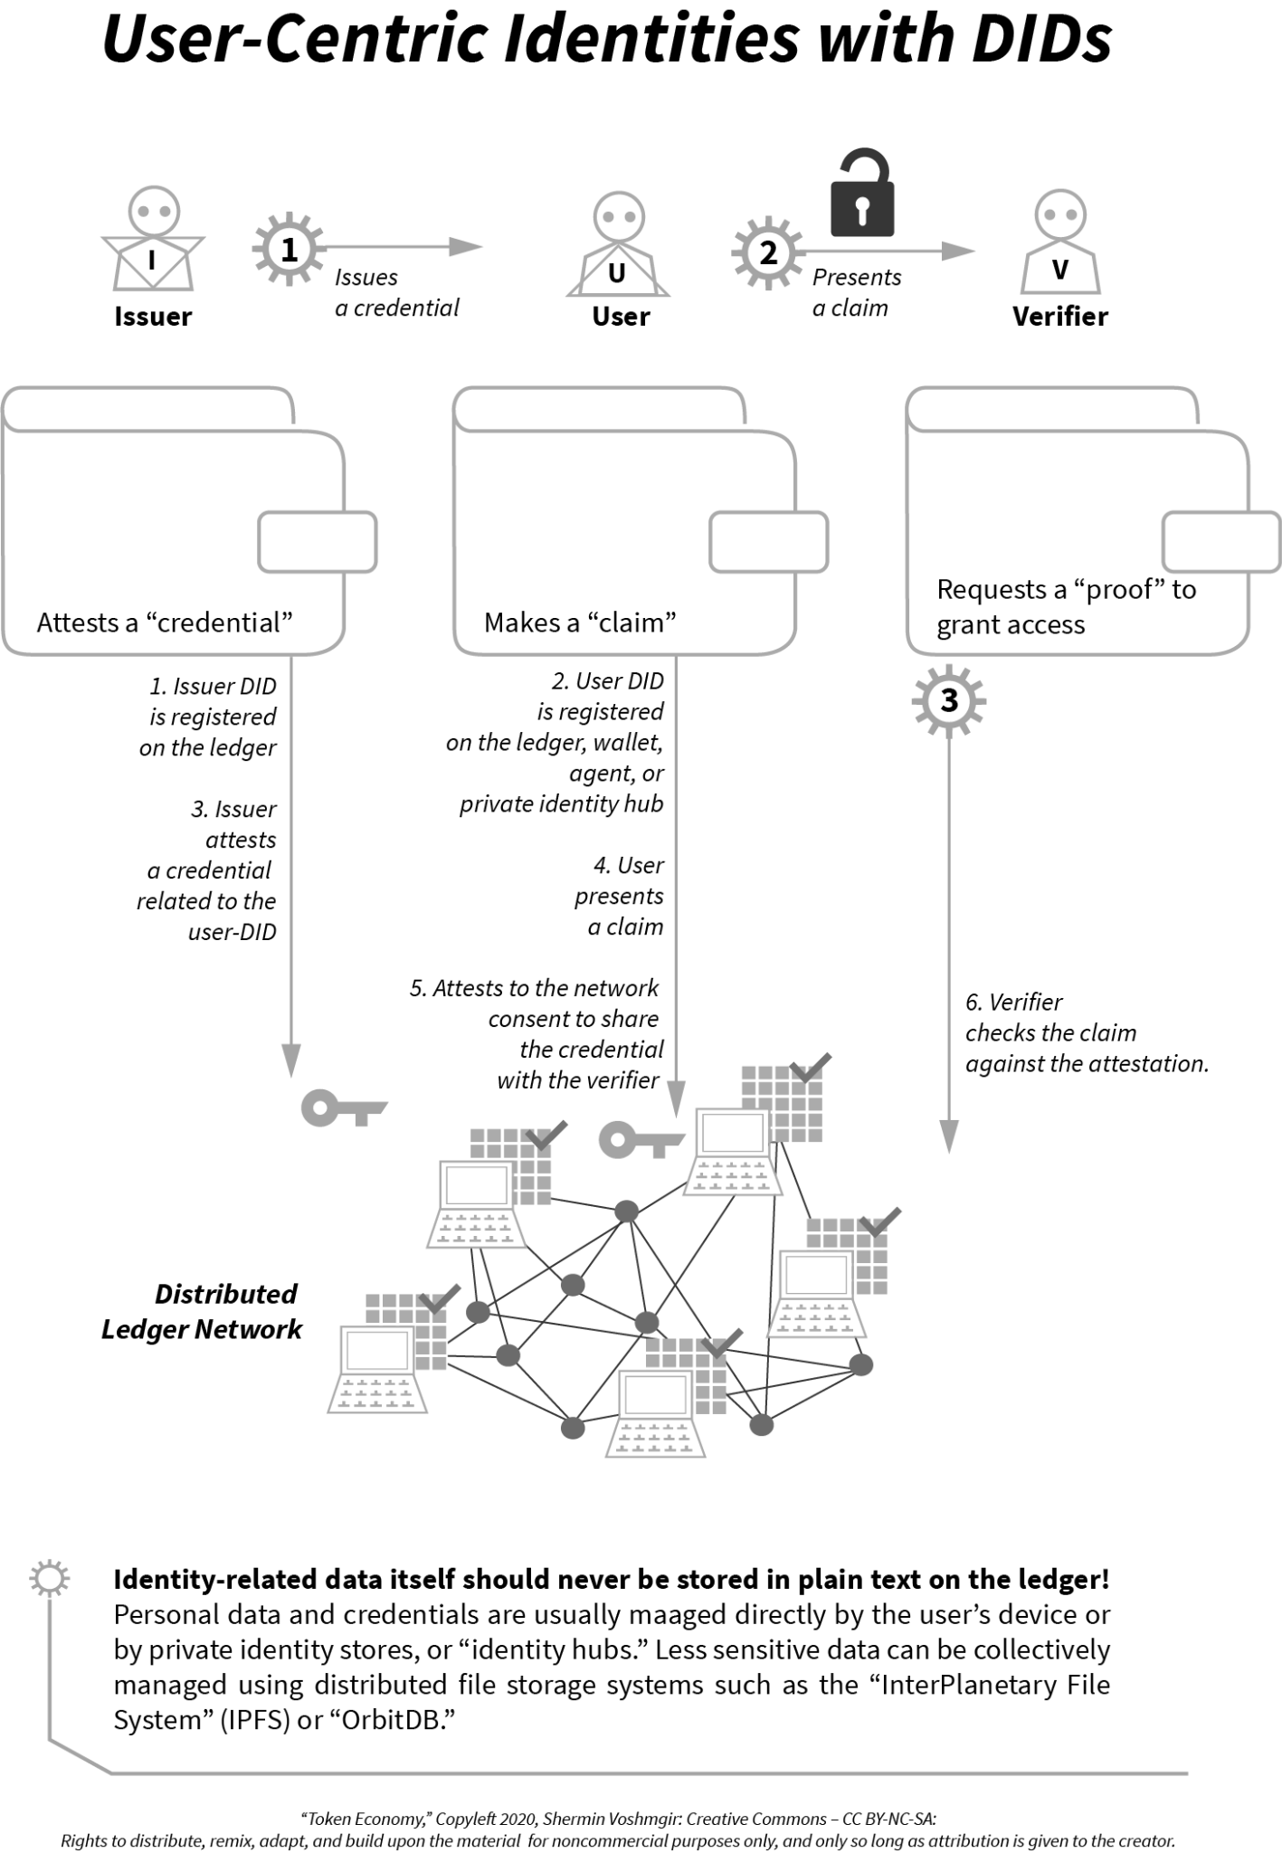
Notes:
https://github.com/sherminvo/TokenEconomyBook/blob/main/imgs/29_UserCentricIdentities.png

Slide 43
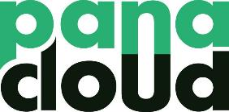
Thank You
Platform for the Serverless API Economy
Fusing Serverless, AI, IoT, Blockchain, and Quantum Technologies
in Next-Gen APIs

